Slide 1
Review on Image Caption
SHUYAN LI

Slide 2
catalogue
Evaluation metrics & dataset
methods
Introduction

Slide 3
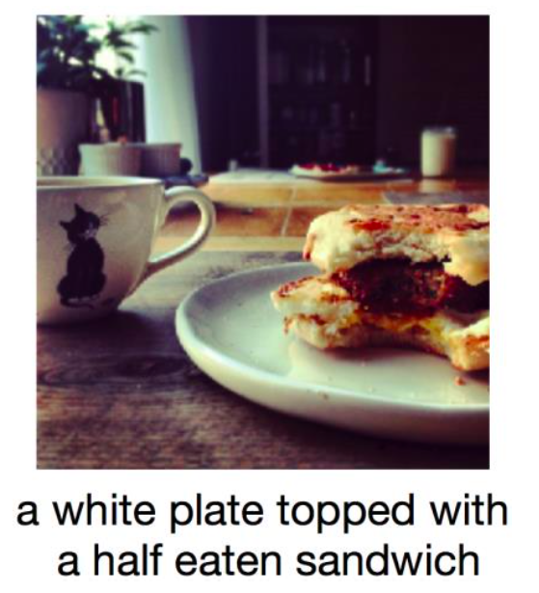
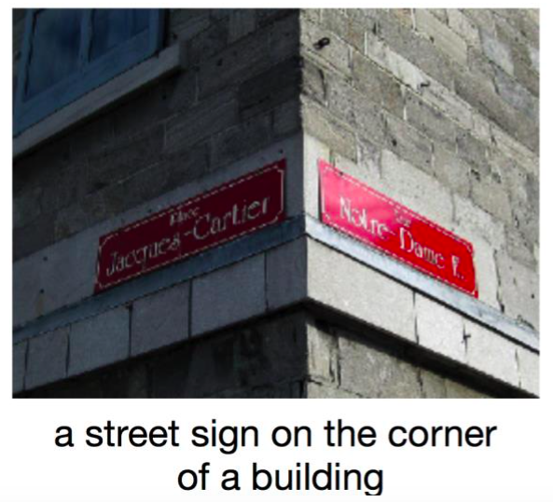
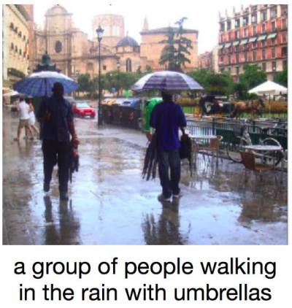
Why Image Caption
Automatically describing the content of an image
have great impact -- for instance by helping visually impaired people better understand the content of images on the web.
Images are from teaching materials of pattern recognition

Slide 4
Evolution
1999
2010
2011
2014
2015
2016
2017
Dividing & vector
quantizing
triplet
Im2Text
mRNN
img-sen mapping
NIC
MSR
MSR Captivator
LRCN
gLSTM
Text-condition
Hard&Soft attention
LSTM-A
Att-CNN+LSTM
When to look
self-critical
1st image annotation
system
Rely on hard-coded visual concepts
Retrieval-based or template-based
DCNN-based features extraction

Slide 5
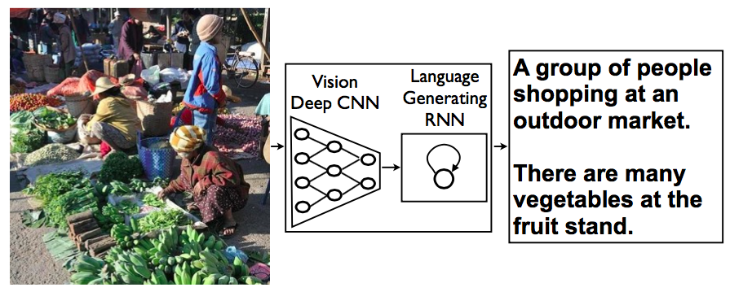
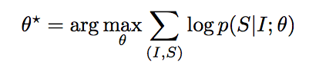
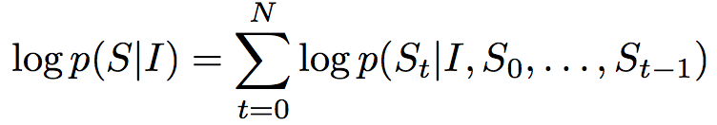
Model
Based end-to-end on a neural network consisting of a vision CNN followed by a language generating RNN.
maximize the probability of the correct description given the image by using
Θ:parameters of our model
I: an image S: the sentence
Images are from Show and Tell: A Neural Image Caption Generator

Slide 6
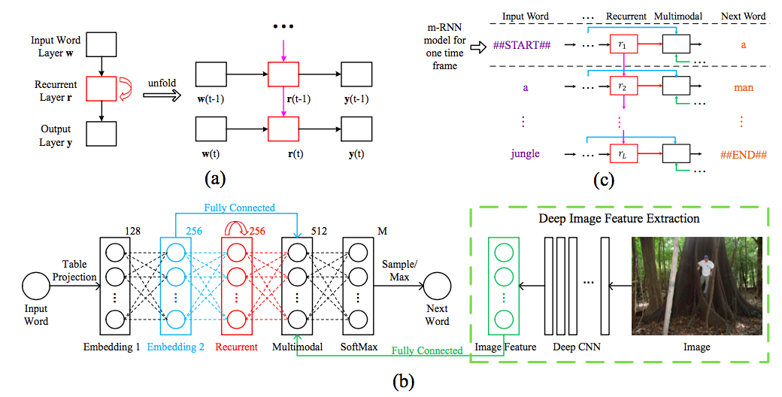


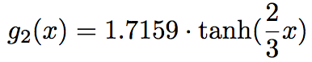
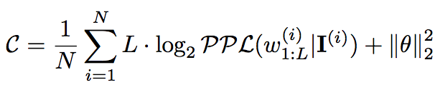
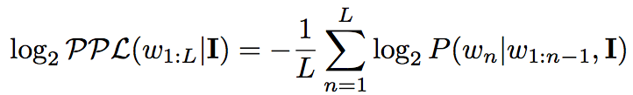
mRNN (Arxiv’14) 132 citations
where f₂ is ReLU
w means the word, I means image
Using softmax to generate the
probability distribution
Define cost function as
where
Drawback: vanishing and exploding gradients
Explain Images with Multimodal Recurrent Neural Networks

Slide 7
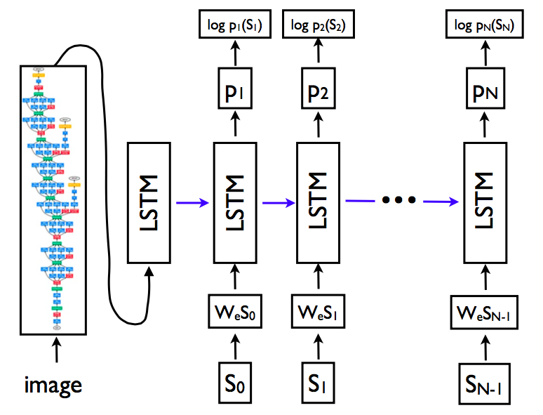
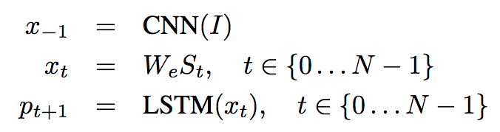
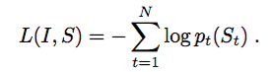
NIC(CVPR’15) 892 citations
I: the input image
S = (S₀,...,S_{N}) : true sentence describing the image
S₀ a special start word
S_{N} a special stop word
Show and Tell: A Neural Image Caption Generator

Slide 8
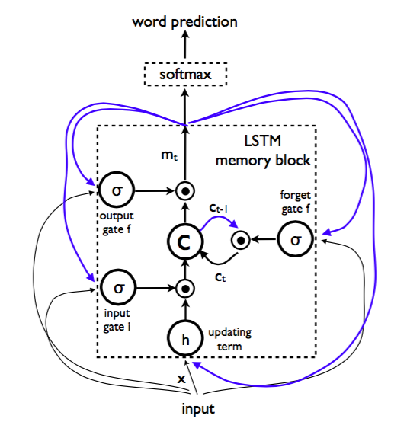
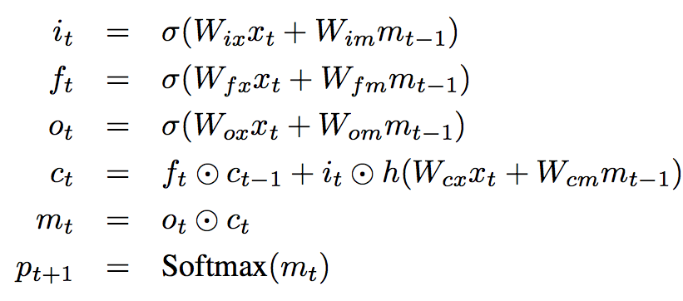
LSTM-based Sentence Generator
Cell: the core of the LSTM(Long Short-Term Memory)
Controlled by three gates:
forget gate f input gate i output gate o
Images are from Show and Tell: A Neural Image Caption Generator

Slide 9
NIC(Conti.)
Inference:
GreedySearch:
sample the first word according to p1, then provide the corresponding embedding as input and sample p2
BeamSearch:
iteratively consider the set of the k best sentences up to time t as candidates to generate sentences of size t + 1, and keep only the resulting best k of them.
Show and Tell: A Neural Image Caption Generator

Slide 10
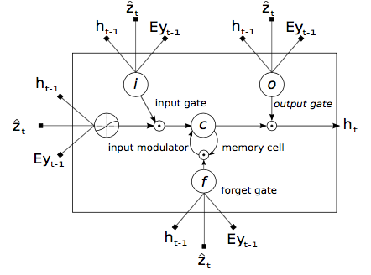
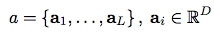
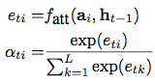

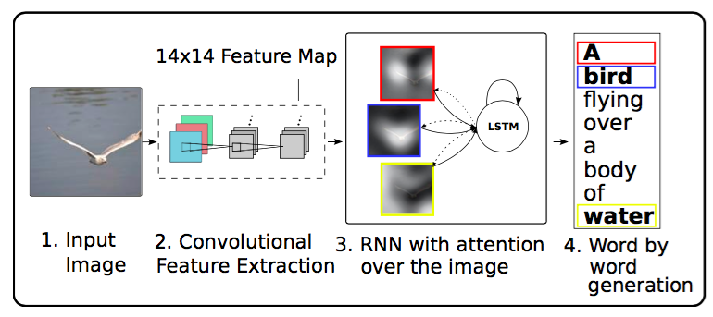
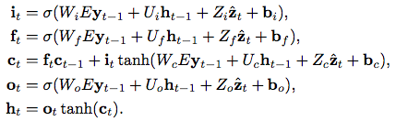
Soft&hard-attention(ICML’16) 590 citations
Use attention to help to predict next word
：features extracted by convolutional layer
：context vector
Show, attend and Tell: A Neural Image Caption Generator

Slide 11
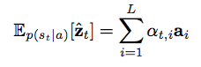
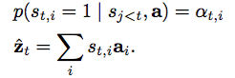
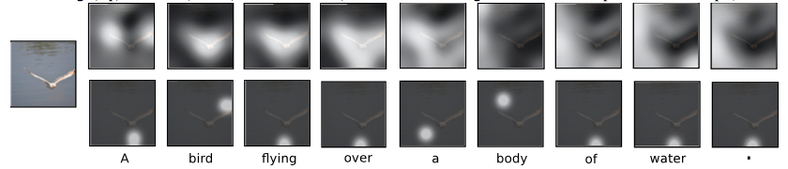
Soft&hard-attention(Conti.)
Two alternative mechanisms for the attention model f_{att} (.):
Stochastic “Hard” Attention
s_{t,i} is an indicator one-hot variable which is set to 1 if the i-th
location (out of L) is the one used to extract visual features.
Assign a multinoulli distribution parametrized by {α_{i}}, and view
zˆ_{t} as a random variable.
Deterministic “Soft” Attention
take the expectation of the context vector zˆ_{t} directly
Show, attend and Tell: A Neural Image Caption Generator

Slide 12
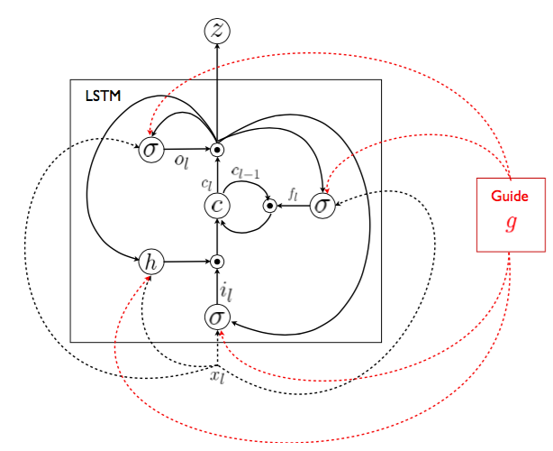
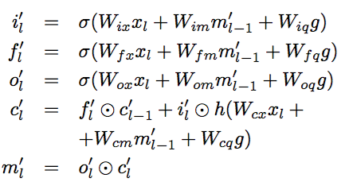
gLSTM(Arxiv’15) 24 citations
g denotes the vector representation of semantic information
g works as a global guide during the caption generation and doesn’t depend
on the time-step
Get the helpful semantic information:
Semantic embedding guidance (emb-gLSTM)
Using normalized CCA as the extra input
Guiding the Long-Short Term Memory Model for Image Caption Generation

Slide 13
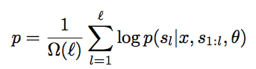
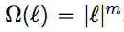
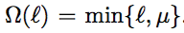
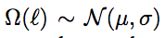
gLSTM(Conti.)
Beam search with length normalize to remedy
the bias towards short sentences:
polynomial normalization
Min-hinge normalization
Gaussian normalization
Compared with NIC:
Less “drift away” of “lose track”
Compared with soft&hard attention:
Uses global cues and doesn’t require location
sampling both during training and testing.
Guiding the Long-Short Term Memory Model for Image Caption Generation

Slide 14
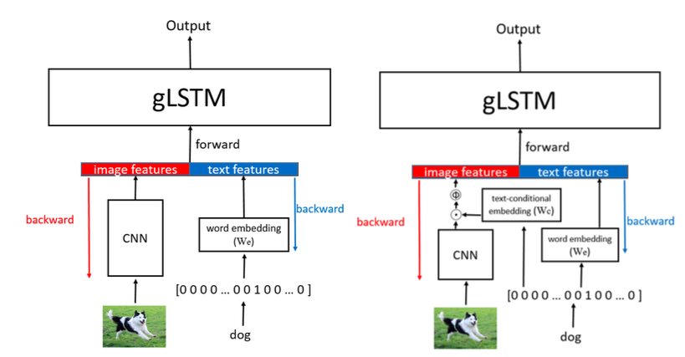
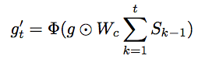
Text-condition(CVPR’16) 4 citations
Contributes:
Learn context-related semantic guidance automatically
First apply gLSTM to image caption generation in
an end-to-end manner
Introduce a new guidance:
g represents the raw guidance feature (image features)
First train the gLSTM(left) model
Initial W_{c} as all-one matrix then train the text-conditional
model(right)
Image Caption Generation with Text-Conditional Semantic Attention

Slide 15
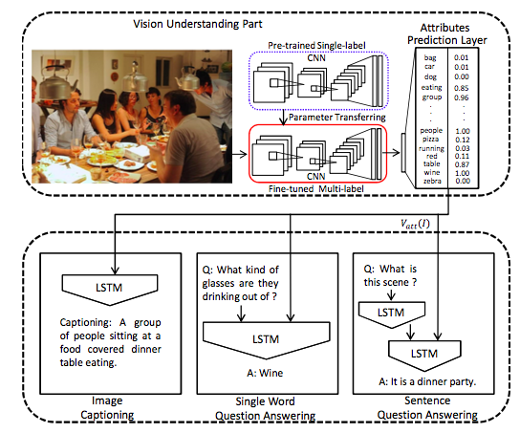
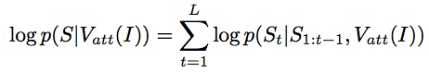
Att-CNN+LSTM(CVPR’16) 9 citations
Use an explicit representation of attributes of the scene
as high-level information similar to LSTM-A
Extract semantic attributes from training captions and
build attribute vocabulary
Treat attributes prediction as a multi-label classification
problem and use deep CNN to get the semantic attribute
prediction probability V_{att}(I)
The log-likelihood of the words can be written as
What Value Do Explicit High Level Concepts Have in Vision to Language Problems?

Slide 16
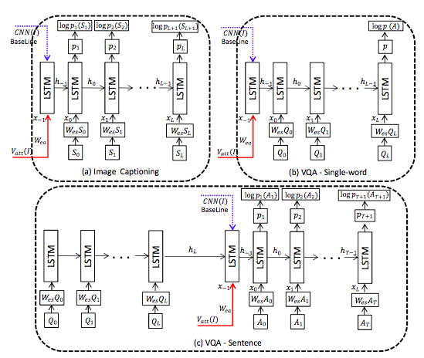
Att-CNN+LSTM(Conti.)
Language generators for different types of tasks:
(a) Image Captioning
(b) VQA-single word
(c) VQA-sentence
What Value Do Explicit High Level Concepts Have in Vision to Language Problems?

Slide 17
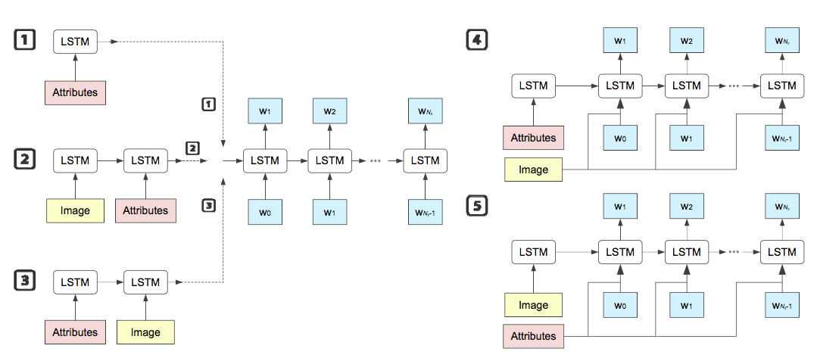
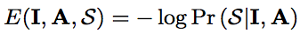
Boost(ICLR’16) 8 citations
Use semantic attributes as extra input
Using multiple Instance Learning (MIL) and treat
the final image-level response probabilities of all
the attributes as A
minimize
1,2,3: where to feed attributes
4,5: when to input attributes or image to LSTM
3 and 5 have top performance
BOOSTING IMAGE CAPTIONING WITH ATTRIBUTES

Slide 18
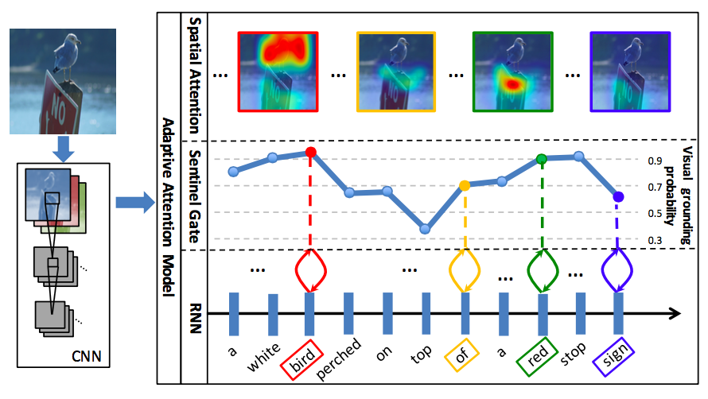
Knowing when to look(CVPR’17) 15 citations
Image information is not needed when:
No-visual information such as “the”
Visual word which can be predict reliably from the language model.
Contributes:
A new spatial attention model
Decide when to look at the image
Knowing When to Look: Adaptive Attention via A Visual Sentinel for Image Captioning

Slide 19
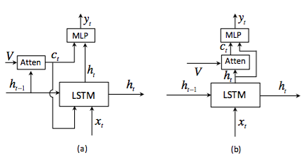
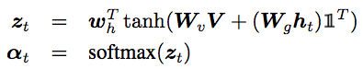
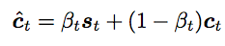
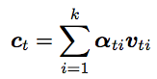
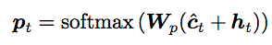
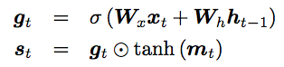
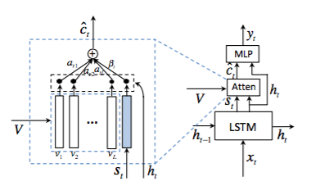

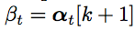
When to look(Conti.)
Model (b) compared with s&h attend(a)
Calculate context vector c_{t} :
The mixture model is:
The probability of
possible words:
Obtain “visual sentinel” vector s_{t}
Add “visual sentinel”
where m_{t} is the memory cell
calculateβ_{t} :
Knowing When to Look: Adaptive Attention via A Visual Sentinel for Image Captioning

Slide 20
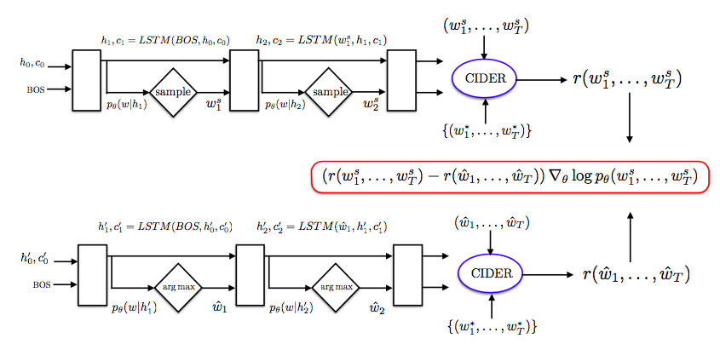
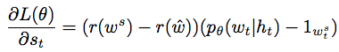
SCST(CVPR’17)
Problems to solve:
mismatch between training and testing
trained using the cross entropy loss, while
typically evaluated at test time using discrete
and non-differentiable NLP metrics
Solution:
baseline the REINFORCE algorithm with
the reward obtained by the current model
under the inference algorithm used at test time
Self-critical Sequence Training for Image Captioning

Slide 21
Results
Result on COCO dataset
 | CIDEr | Meteor | BLEU-1 | BLEU-2 | BLEU-3 | BLEU-4
NIC | 0.943 | 0.254 | 0.713 | 0.542 | 0.407 | 0.309
MS Captivator | 0.912 | 0.291 | 0.695 | - | - | 0.291
Soft-attention | - | 0.239 | 0.707 | 0.492 | 0.344 | 0.243
Hard-attention | - | 0.23 | 0.718 | 0.504 | 0.357 | 0.25
gLSTM | 0.677 | 0.204 | 0.647 | 0.459 | 0.311 | 0.214
Text-condition | 0.959 | 0.245 | 0.72 | 0.546 | 0.404 | 0.298
Att-CNN-LSTM | 0.94 | 0.26 | 0.74 | 0.56 | 0.42 | 0.31
LSTM-A | 0.986 | 0.251 | 0.73 | 0.565 | 0.429 | 0.325
When to look | 1.085 | 0.266 | 0.742 | 0.58 | 0.439 | 0.332
Data from http://mscoco.org/dataset/#captions-leaderboard

Slide 22
Experiments
Train set: 8000 images, 5 describing sentences in Chinese for each Validation set: 2000 images, 5 describing sentences in Chinese for each Test set: 1000 images | Train set: 82783 images, 5 describing sentences in Chinese for each Validation set: 40504 images, 5 describing sentences in Chinese for each Test set: 40775 images
Embedding size: 256 | Platform: Keras
Train on NVIDIA GPU | Number of layers: 1
Batch size: 128 | Optimization: SGD
Inference : greedy & beam size of 3

Slide 23
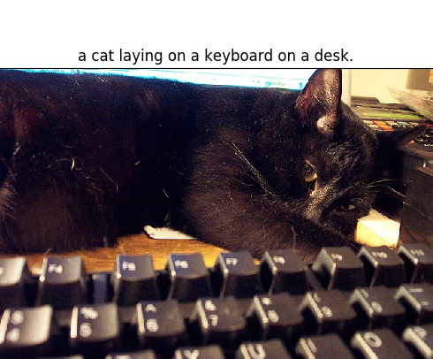
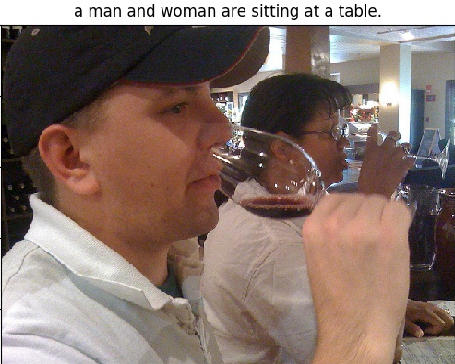
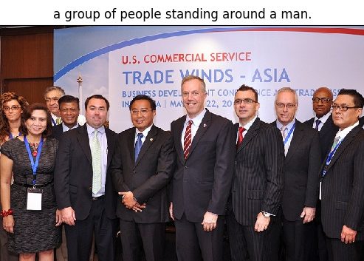
Results
Some good results:

Slide 24



Results
Some poor results:

Slide 25

Results
Some good results:
No beam search
一个有床和一个大床的房间
Beam size ：
房间里有一张大床
Comparison：
床上挂着长长的帘子
床上铺着白底素花图案的床单
一个张铺着白色辈子有窗幔的
豪华大床
一间很典雅的卧室，挂有一幅画像
房间里有一张华贵的床

Slide 26

Results
Some good results:
Generated：
房间里有一张大床
Comparison：
床上挂着长长的帘子
床上铺着白底素花图案的床单
一个张铺着白色辈子有窗幔的
豪华大床
一间很典雅的卧室，挂有一幅画像
房间里有一张华贵的床
Generated：
一群人在球场上打棒球
Comparison：
几个人在体育场上奔跑
棒球比赛里两队在争球
选手在本垒打棒后跑向一垒
运动员在球场上打棒球
几个垒球运动员正在比赛

Slide 27


Results
Some poor results:
Generated： 两只熊在草地上行走
Candidates：
一只大熊和两只小熊
水边有两头小熊和一头大熊
河里站着三只灰熊
三只熊在河边饮水
棕熊一家在水里捉鱼
Generated：
一辆自行车的后座上放着一只狗
Candidates:
一辆摩托车停在一群人旁边
一辆摩托车旁边站着很多人
一群人围在一台棕色的摩托车旁边
一辆香槟色摩托车后面站着一帮人
在地上有一辆米色的摩托车

Slide 28
Results
 | BLEU-1 | BLEU-2 | BLEU-3 | BLEU-4 | ROUGE | CIDEr
Greedy(Chinese) | 0.667 | 0.523 | 0.4 | 0.31 | 0.503 | 1.063
Greedy(MS COCO) | 0.669 | 0.525 | 0.41 | 0.31 | 0.505 | 1.065
Beam search | 0.677 | 0.546 | 0.436 | 0.349 | 0.516 | 1.163

Slide 29
THANKS！

